Slide 1
10910EECS204001 Data Structures Homework 6
2020/12/29 18:00
~
2021/1/18 23:59

Slide 2
HW6
In this homework, you have to solve the minimum diameter spanning tree(MDST) problem
MDST: Given a connected weighted graph G, find the spanning tree of G that maximal distance between vertices is minimal. -> Diameter: maximal distance between vertices in a tree
The graph is undirected and positive weighted

Slide 3
Operations
1. Add
2. Delete
3. AC
4. Diameter
5. SOSPD

Slide 4
Add
Add v1 v2 w
Add an edge between v1 and v2 and the weight is w
Ex: Add 0 1 10
If there already exists an edge, update to the new one
(delete the original one and add the new edge)
0
10
1

Slide 5
Delete
Delete v1 v2
Delete the edge between v1 and v2
Ex: Delete 0 1
0
10
1

Slide 6
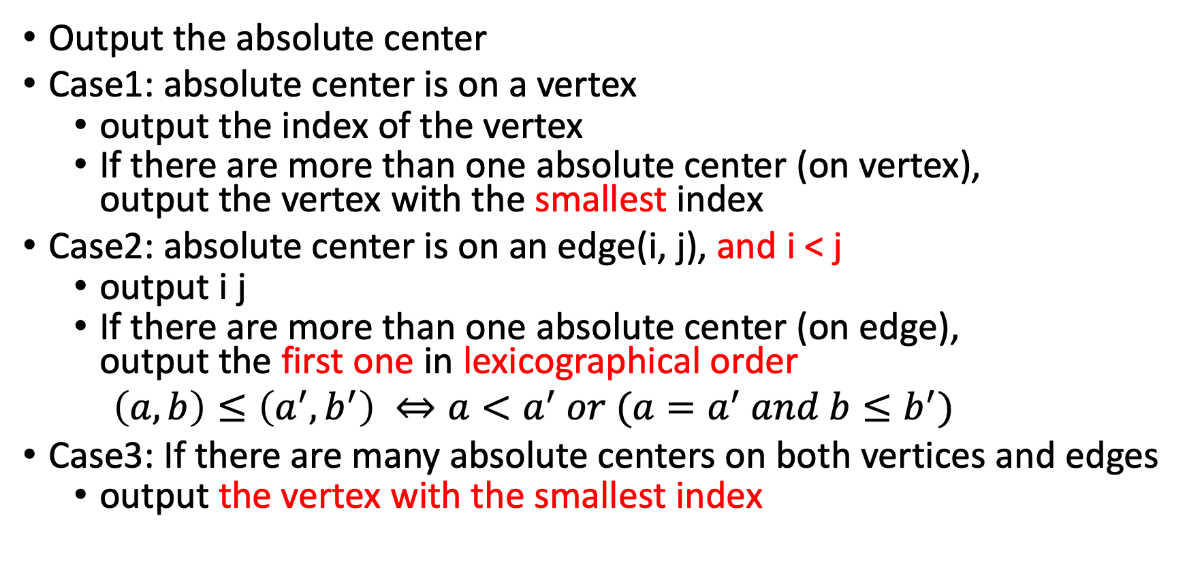
AC
Output the absolute center
Case1: absolute center is on a vertex
output the index of the vertex
If there are more than one absolute center (on vertex), output the vertex with the smallest index
Case2: absolute center is on an edge(i, j), and i < j
output i j
If there are more than one absolute center (on edge), output the first one in lexicographical order
$\left(a,b\right)≤\left(a^{′},b^{′}\right) ⇔a<a^{′} or (a=a^{′} and b≤b^{′})$
Case3: If there are many absolute centers on both vertices and edges
output the vertex with the smallest index

Slide 7
AC
If the graph is not connected,
output “Not connected graph”

Slide 8
Diameter
Output the diameter of MDST
If the graph is not connected,
output “Not connected graph”

Slide 9
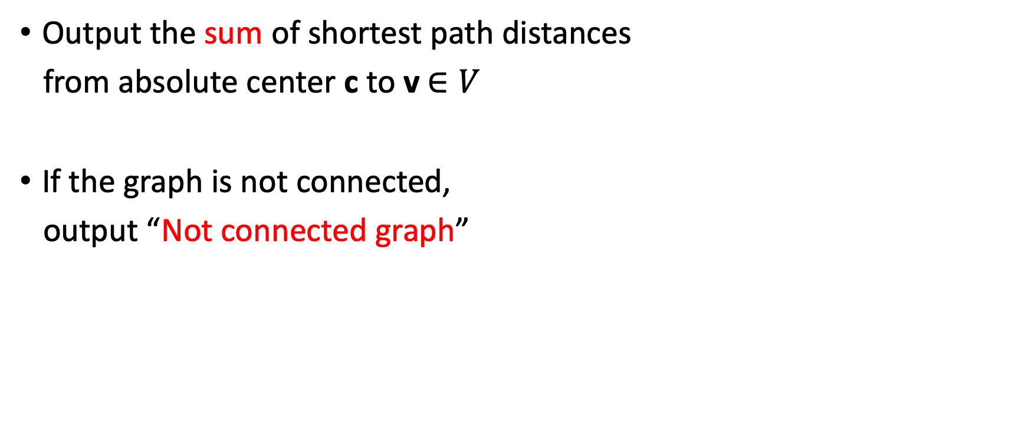
SOSPD
Output the sum of shortest path distances
from absolute center c to v$∈V$
If the graph is not connected,
output “Not connected graph”

Slide 10
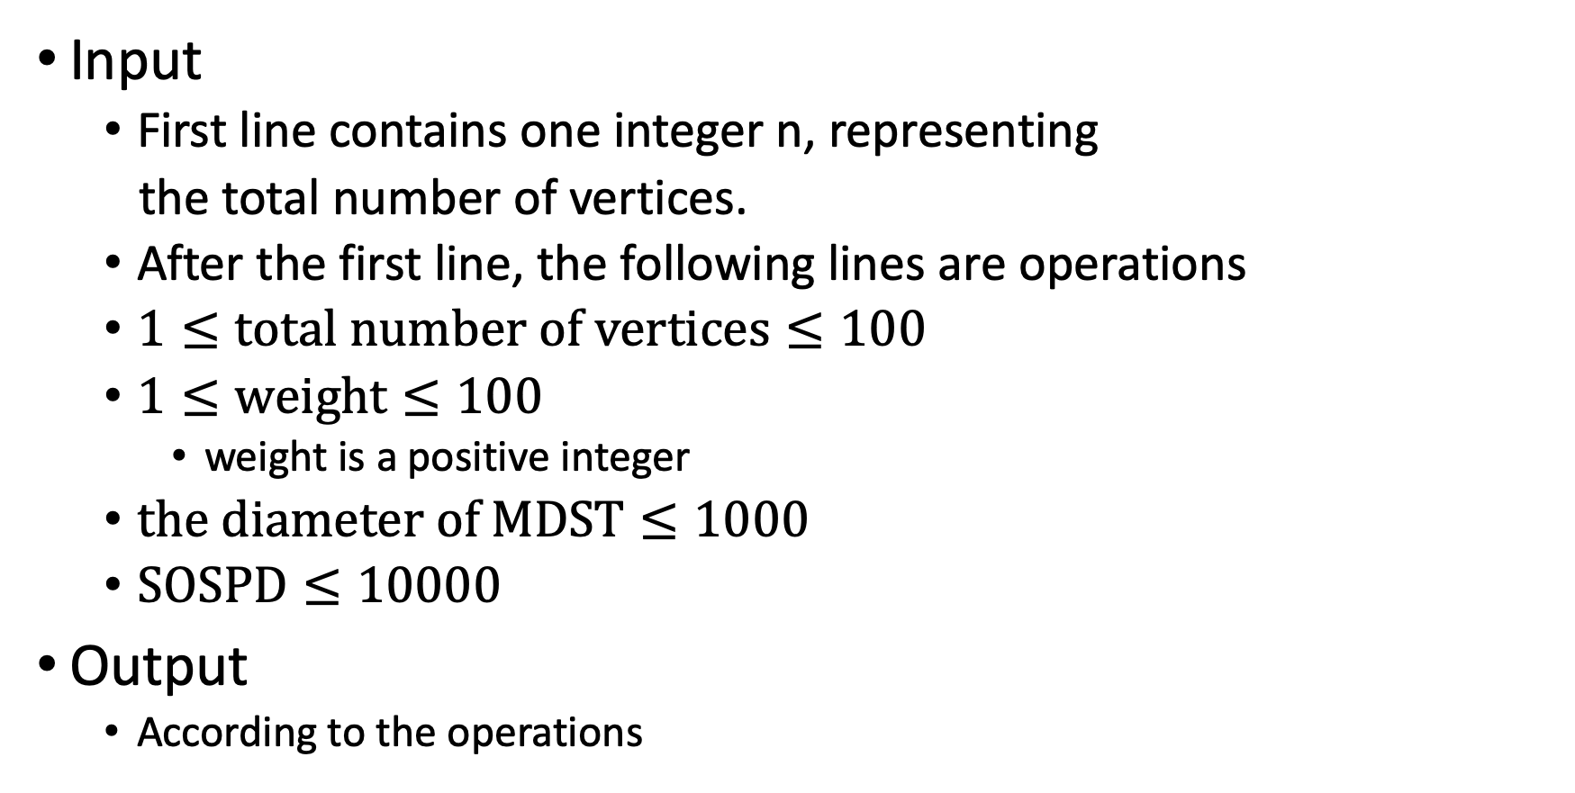
Input & Output
Input
First line contains one integer n, representing
the total number of vertices.
After the first line, the following lines are operations
$1≤total number of vertices≤100$
$1≤weight≤100$
weight is a positive integer
$the diameter of MDST≤1000$
$SOSPD≤10000$
Output
According to the operations

Slide 11
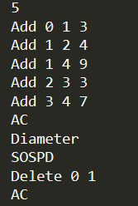

Sample Input & Sample Output
Input Output

Slide 12
Material of MDST
The problem C in this website is the description and solution of MDST.
https://web.archive.org/web/20160309101249/https://adn.botao.hu/adn-backup/blog/attachments/month_0705/32007531153238.pdf

Slide 13
The End

